Slide 1


World energy production and consumption analysis
Bogineni Krishna Satya Sai Ram
AP21110010619

Slide 2

AIM
d
The aim of this data analysis visualization project is to provide a overview of the world's energy landscape from 1973 to 2022. By analyzing monthly data on energy production, consumption, imports, exports and utilization from various resources such as renewables, nuclear, and fossil fuels, this project aims to identify trends, patterns, and shifts in global energy dynamics. Through interactive visualizations, this analysis seeks to offer insights into energy consumption patterns, resource utilization, and their impact on the global energy market and sustainability.

Slide 3

AGENDA
01
02
03
Abstract
Introduction
System Requrements
04
05
06
Global energy production
Global energy consumption
Production vs Consumption
07
08
09
04
Global energy Analysis
Advantages
Suggestions

Slide 4


Abstract
In this project, we apply data analysis techniques and interactive visualizations to unravel the historical shifts in energy production and consumption patterns. The project explores the interplay between various energy resources and identifies key factors that have shaped the energy landscape over the years. Additionally, we investigate the implications of these trends on sustainability and the environment.
The interactive data visualizations offer an intuitive platform for users to explore and interpret the complex relationships between energy production, consumption, and trade on a global scale.

Slide 5

Introduction
This project mojourly focuses on visualization, In order to have a comprehensive understanding I used graphs , pycharts,
statistics ,wold maps and various plotting techniques that mainly focus on differenciating the energy production and consumption across these five decades.In order to do this I have used three data sets(menctioned below).
World Energy Overview.csv
Production_Total.csv
Consumption_Total.csv
complete data of world energy
energy production data
energy consumption data

Slide 6


System Requirements
Hardware requirements:
8GB RAM
256 or above ssd
Multicore Processor
Preinstalled OS(Windows, macOS, or Linux).
Software requirements:
An IDE such as Jupyter Notebook or Visual Studio Code is recommended
Python 3.x, along with data analysis libraries like Pandas, NumPy, Matplotlib, and Seaborn are necessary
windows XL or any other prefered apps for data sets

Slide 7
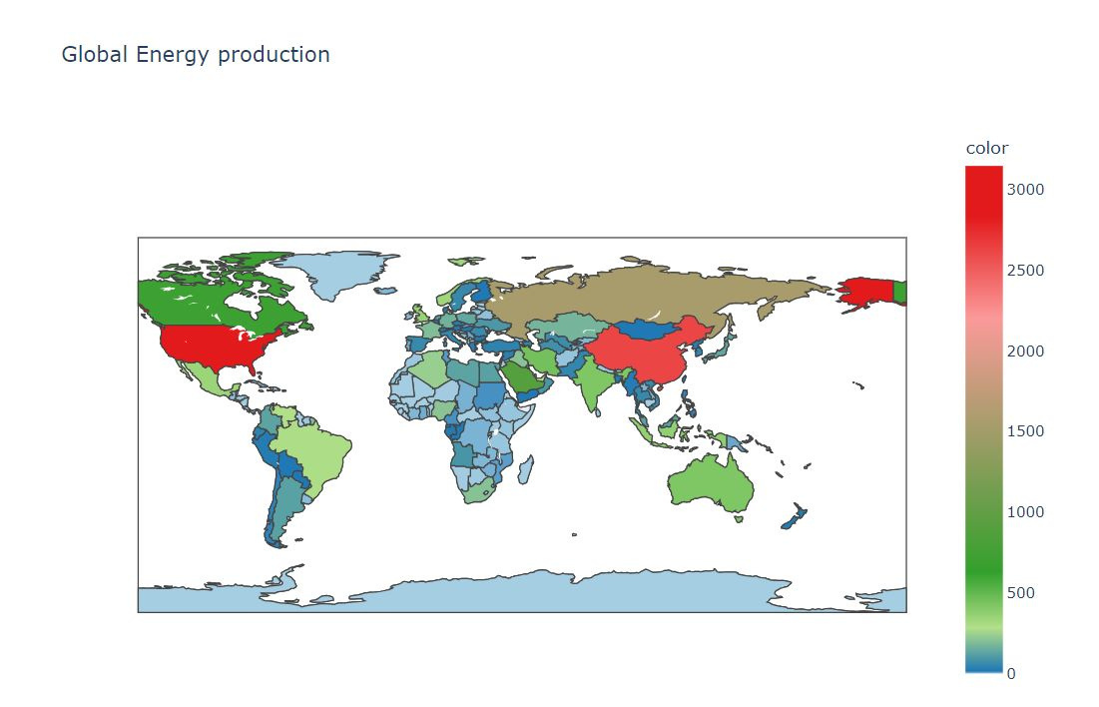
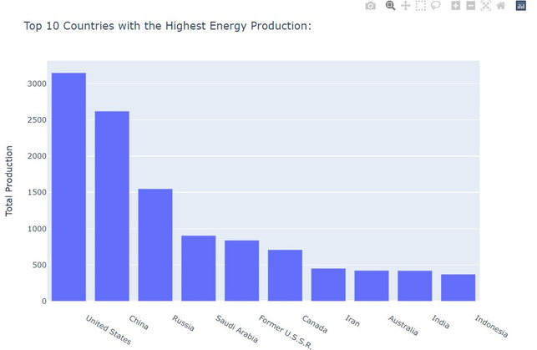
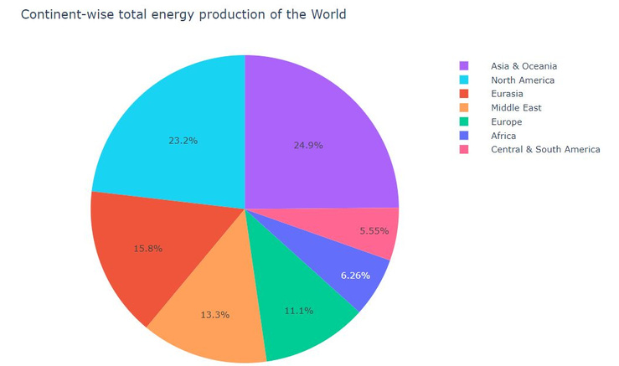
Global energy production
1. The pychart illustrates continent-wise energy production trends over the last 50 years, showcasing the varying contributions of different continents to the global energy landscape.
2.The graphical representation of the top 10 countries in energy production highlights the dominant role played by key players like China, USA, and Russia.
3. The world map visualizes energy production distribution, revealing the geopolitical significance of energy-rich regions and their impact on global energy dynamics.

Slide 8
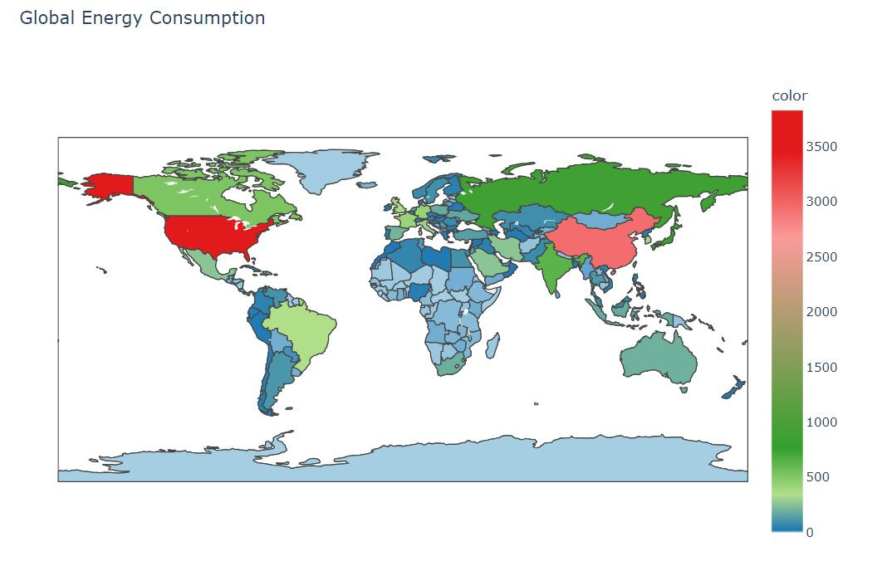
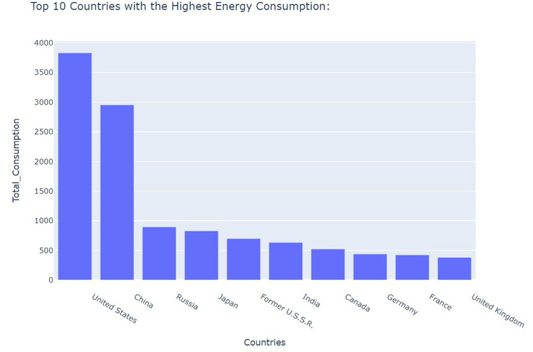
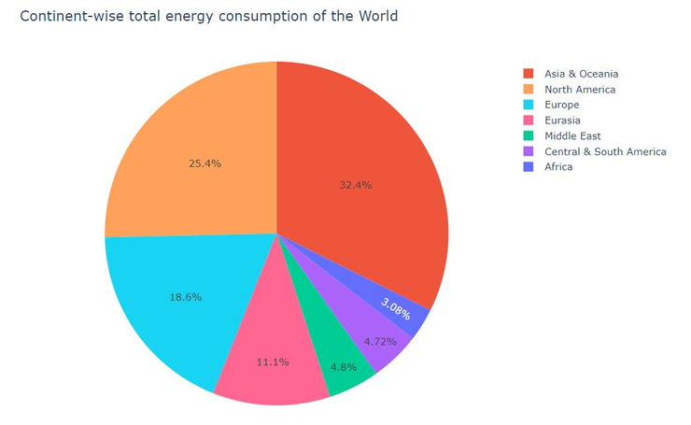
Global energy
consumption
1.The pychart depicting continent-wise energy consumption trends reveals shifts in energy usage across regions over the past five decades, reflecting evolving economic and social factors.
2.The graphical representation of the top 10 countries in energy consumption highlights the significant appetite for energy in densely populated and highly industrialized nations.
3.The world map showcasing energy consumption distribution exposes disparities in energy demand, signifying the need for energy conservation and equitable access to energy resources.
3.The world map showcasing energy consumption distribution exposes disparities in energy demand, signifying the need for energy conservation and equitable access to energy resources.

Slide 9

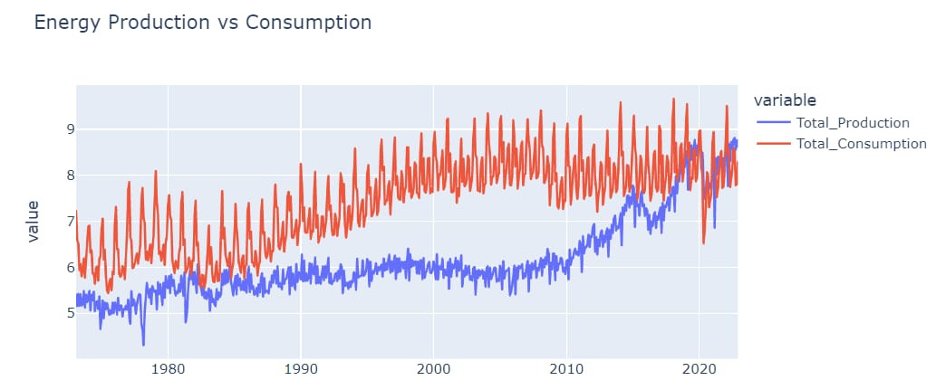
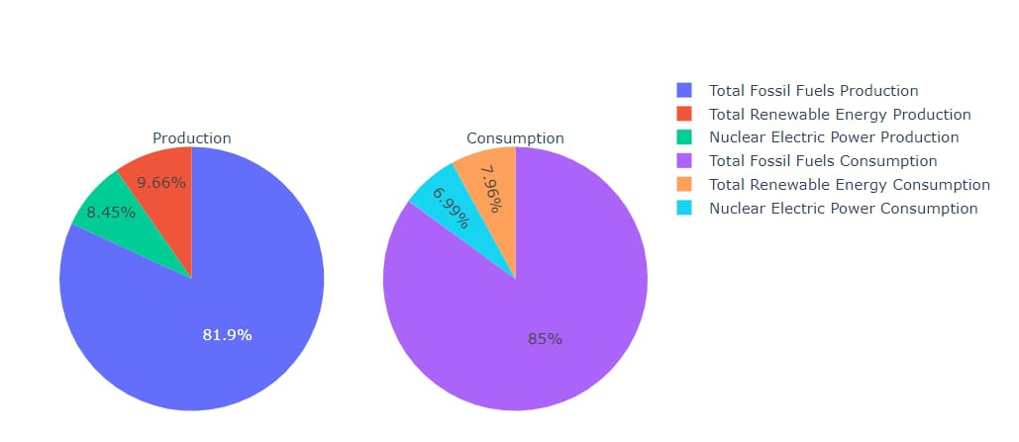
Production vs Consumption
The pie chart illustrating resources used for energy production over the years showcases the diverse mix of energy sources employed, encompassing renewables, fossil fuels, and nuclear energy, indicating efforts towards resource diversification
So by using this representation it is clearly displayed across the years in a detailed way.
The pie chart depicting resources used for energy consumption displays the combination of energy sources employed to meet global energy demands, reflecting the intricate nature of energy consumption patterns.

Slide 10
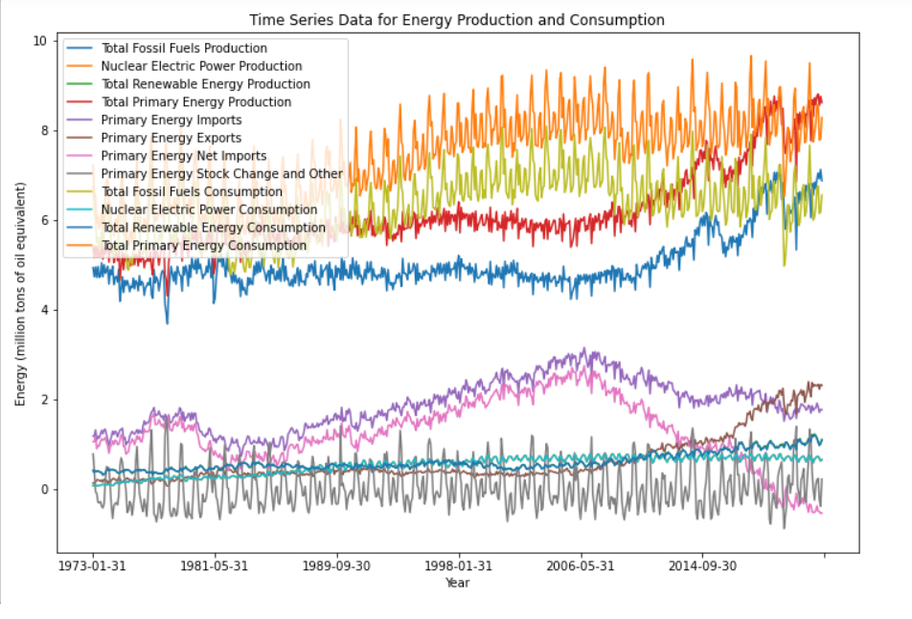
Global
Energy Analysis
--> Here we use datetime format, set it as the index of the DataFrame, and then plots a line chart of the time series data. The chart shows global energy production and consumption over time, with the year on the x-axis and energy usage on the y-axis.
--> The "Global Energy Analysis" page presents time series data on production (fossil fuels, nuclear, renewables) and consumption trends, highlighting the rise of renewables and energy trade dynamics. The analysis offers insights into sustainable practices, diversification, and energy security for a resilient global energy future.

Slide 11

Advantages
1 . Comprehensive Energy Analysis
2. Interactive Visualizations for Insights
3. Key Trends Uncovered
4. Long-Term Planning Perspective
5. Promoting Energy Literacy
6. Enhancing an idea in Energy Management
Overall, this project serves as a valuable resource for anyone seeking in-depth knowledge about the world's energy overview, promoting informed decision-making, sustainable energy practices, and a more secure and resilient energy future for the planet.

Slide 12

Suggestions
1. Prioritize Renewable Energy Investments:Channel resources into developing and deploying renewable energy sources to reduce reliance on fossil fuels.
2. Promote Energy Efficiency Measures: Encourage adoption of energy-efficient technologies and practices to balance energy supply and demand.
3.Diversify Energy Sources: Foster a mix of energy resources, including renewables, nuclear, and clean technologies, to enhance energy security.
4. Strengthen International Energy Cooperation:Foster transparent and fair energy trade agreements to ensure a reliable supply of resources.
5. Establish Long-Term Sustainable Energy Policies: Develop comprehensive policies that prioritize sustainability and adaptability to address future energy challenges.

Slide 13

1. Shifting Power Balance: China's emergence as an energy sector leader surpassing the USA signifies a changing global energy dynamic.
2. Energy Supply-Demand Imbalance: Persistent energy consumption exceeding production calls for sustainable solutions to bridge the gap.
3. Import Dependency Risks: Heavy reliance on energy imports raises concerns about vulnerability to supply disruptions and price fluctuations.
4. Coal Dependence in Asia: Asia's reliance on coal presents challenges for climate change mitigation; promoting renewable energy is vital.
Conclusion and Reference
These conclusions shed light on critical aspects of the world energy overview, emphasizing the need for coordinated efforts among nations to address energy challenges, enhance energy security, and transition towards sustainable energy solutions. Acknowledging the changing power dynamics and promoting sustainable practices will be instrumental in shaping a resilient and environmentally responsible energy future.
Reference :
Kaggle
https://www.kaggle.com/datasets/akhiljethwa/world-energy-statistics

Slide 14

Thank You

